Slide 1
Award Talk: From Genomics to Herd Improvement: Pioneering Strategies in Dairy Cattle Breeding
John B. Cole
2025 ASAS-CSAS Annual Meeting| July 8, 2025

Slide 2
Topics
Current landscape
Genomic tools
Genomic prediction methods
Unexpected applications
Future directions
Acknowledgments

Slide 3
Current landscape

Slide 4

Dairy cattle selection before genomics
Slow!
  Progeny test for production took 3–4 years from insemination
  Bull at least 5 years old before first evaluation available
Expensive!
  Progeny testing cost US$25,000–50,000 per bull
  Only 1 in 8–10 bulls graduated from progeny test
  At least US$200,000 invested in each active bull
  Average active bulls cost about U.S. $350,000–400,000

Slide 5
Why genomics works for dairy cattle
Extensive historical data available
Well-developed genetic evaluation program
Widespread use of artificial insemination
Progeny-test programs
High-value animals worth the cost of genotyping
Long generation interval that can be reduced substantially by genomics

Slide 6
Usable genotypes by year and sex

Slide 7
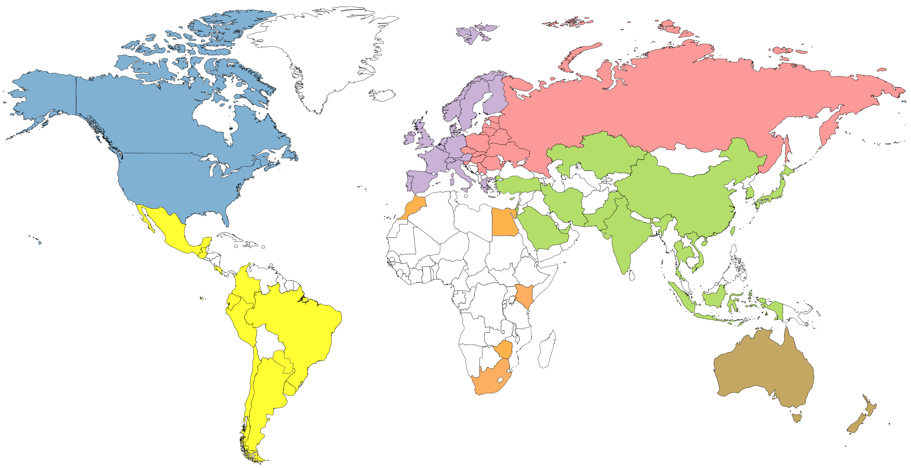
Genotyped animals in database (May 2025)
826,506
240,787
7,315,447
1,024,347
497,713
44,493
179,258

Slide 8

Data quantities (April 2025)
Traits | Counts
Lactations | 109.4 million
Type | 3.0 million
Feed intake | 11,504
Breedings | 100.6 million
Somatic cell | 70.0 million
Calving difficulty | 53.3 million

Slide 9
Genomic prediction methods

Slide 10

How does genetic selection work?
ΔG = genetic gain each year
reliability = how certain we are about an animal’s predicted genetic merit (genomics ⬆)
selection intensity = how selective we are when picking mates (management can ⬆)
genetic variance = genetic variation in the population (we can’t really change this)
generation interval = time between generations (genomics ⬇)
Cole and Spurlock (2016; https://ldhm.adsa.org/)

Slide 11
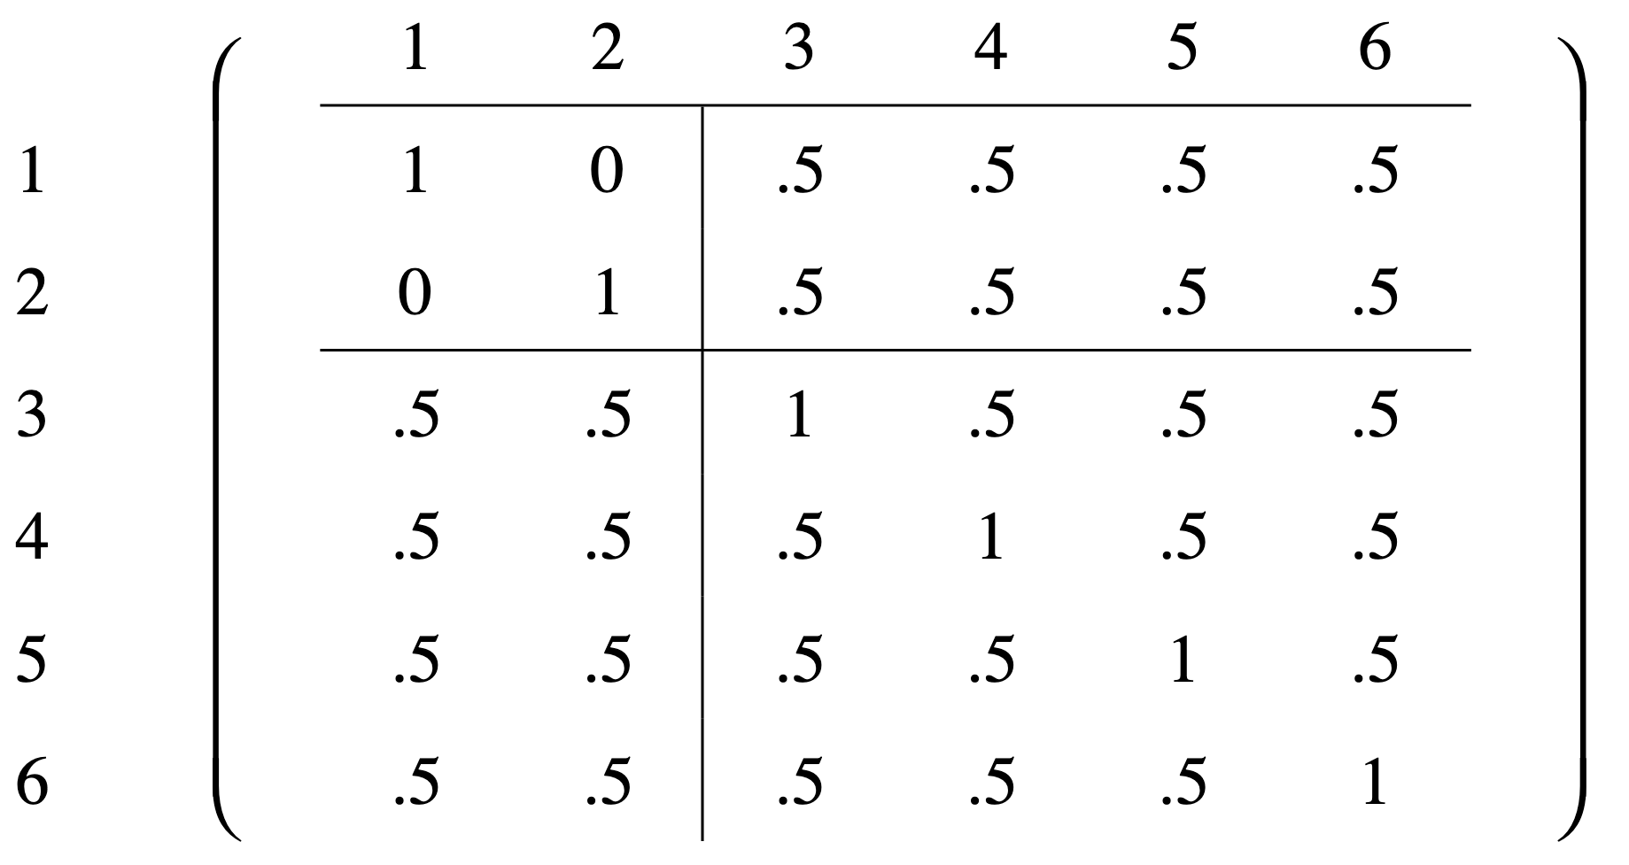
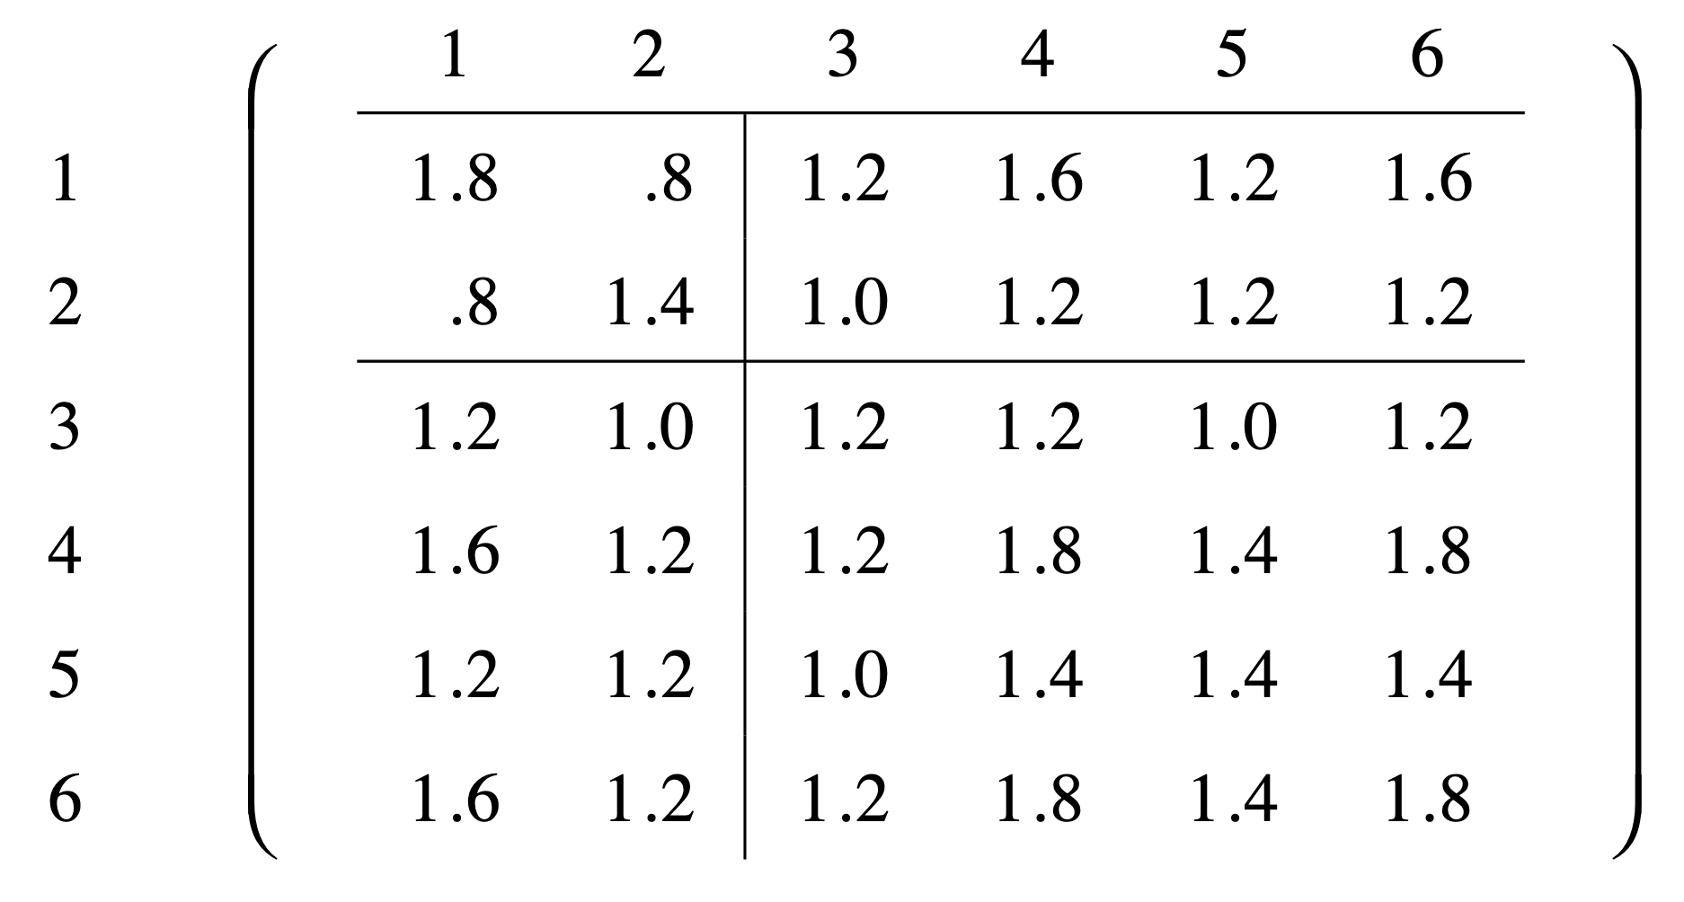
Allelic relationship matrices
Pedigree-derived A
Allelic-based A
Nejati-Javaremi et al. (1997; https://doi.org/10.2527/1997.7571738x)

Slide 12
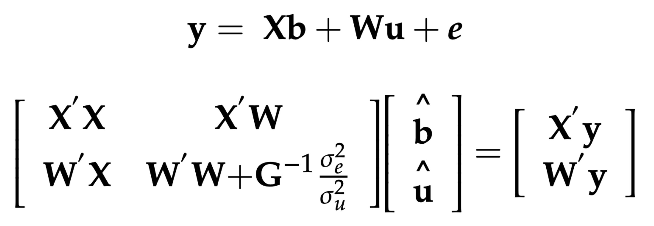
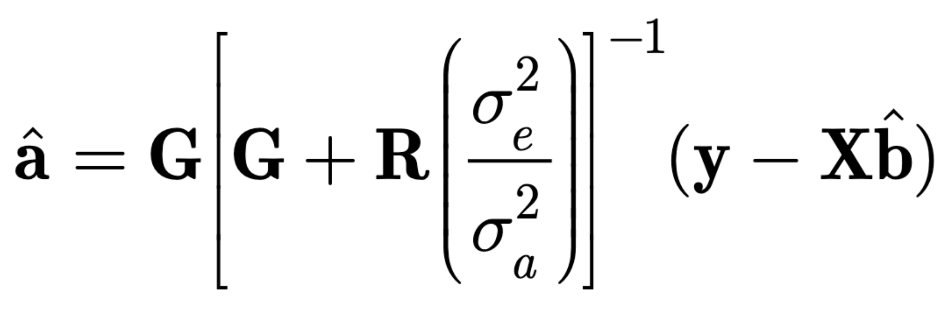
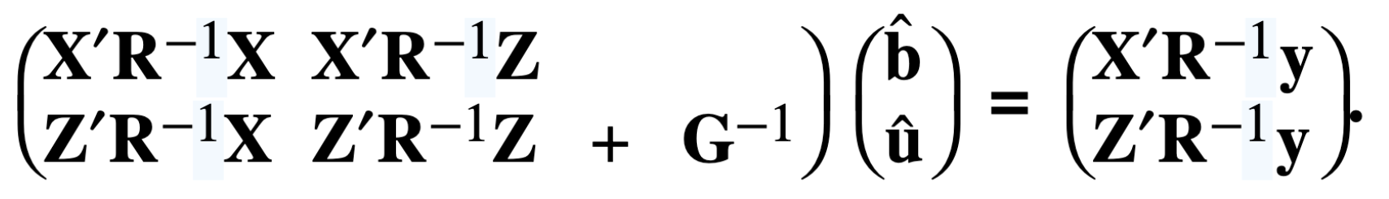
Two-step genomic prediction
Lourenço et al. (2020)
Nejati-Javaremi et al. (1997)
VanRaden et al. (2008)

Slide 13
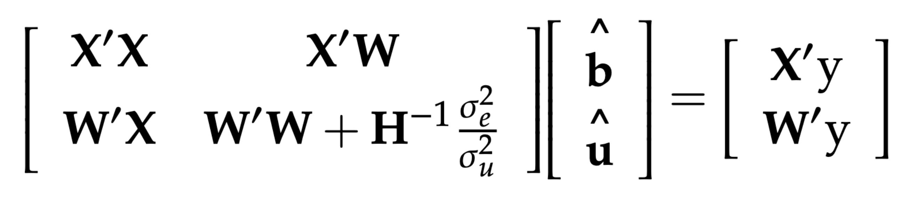
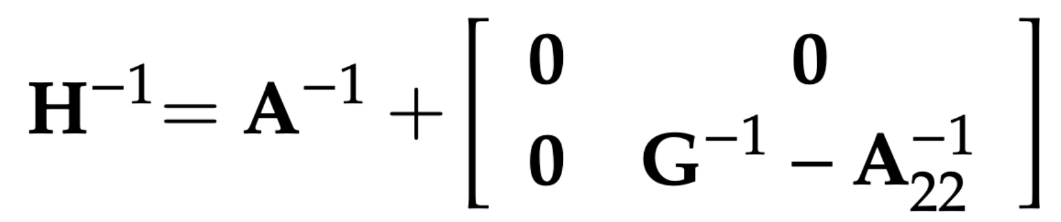
Single-step methodology
Aguilar et al. (2010; https://doi.org/10.3168/jds.2009-2730)

Slide 14
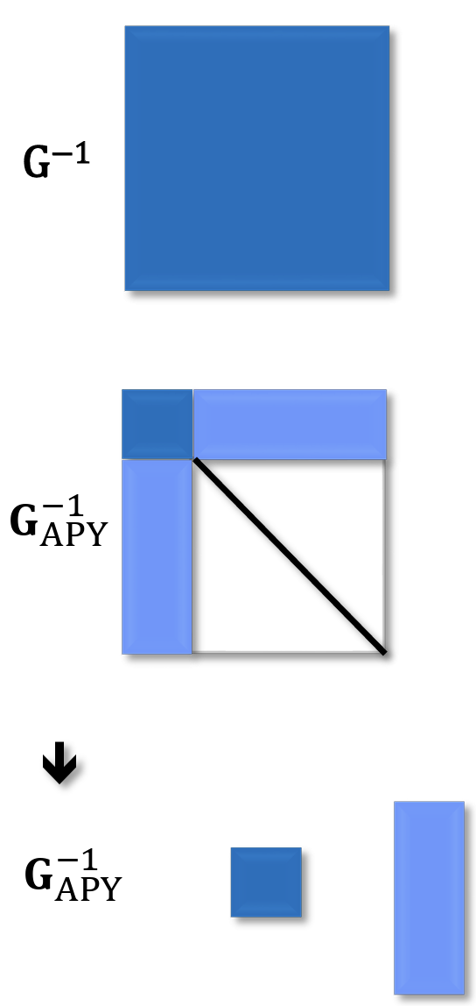
Careful thinking leads to big gains
ssGBLUP problematic when the genotyped population is very large
The Algorithm for Proven and Young (APY) refactors matrices to focus on a core set of animals
Dramatic improvements in performance for large reference populations
Misztal et al. (2014; https://doi.org/10.3168/jds.2013-7752)

Slide 15
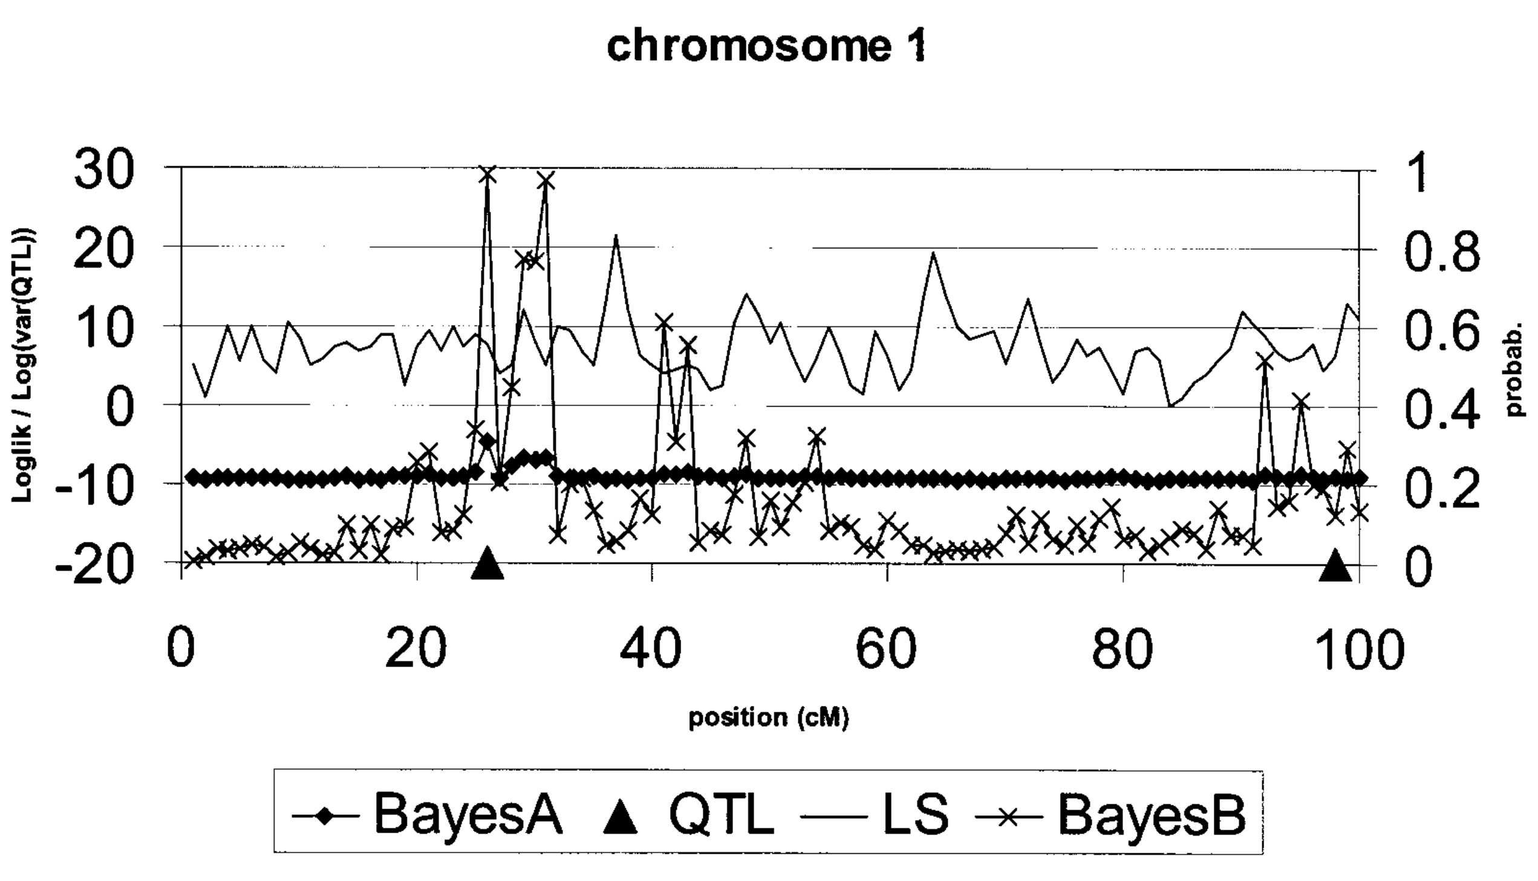
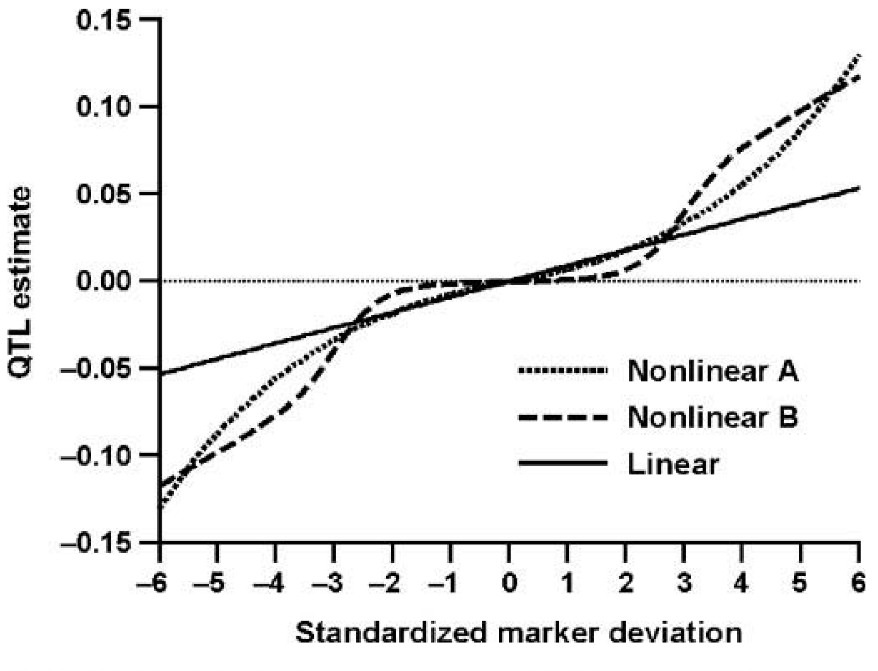
Linear vs. non-linear allele effects
Meuwissen et al. (2001)
VanRaden (2008)

Slide 16
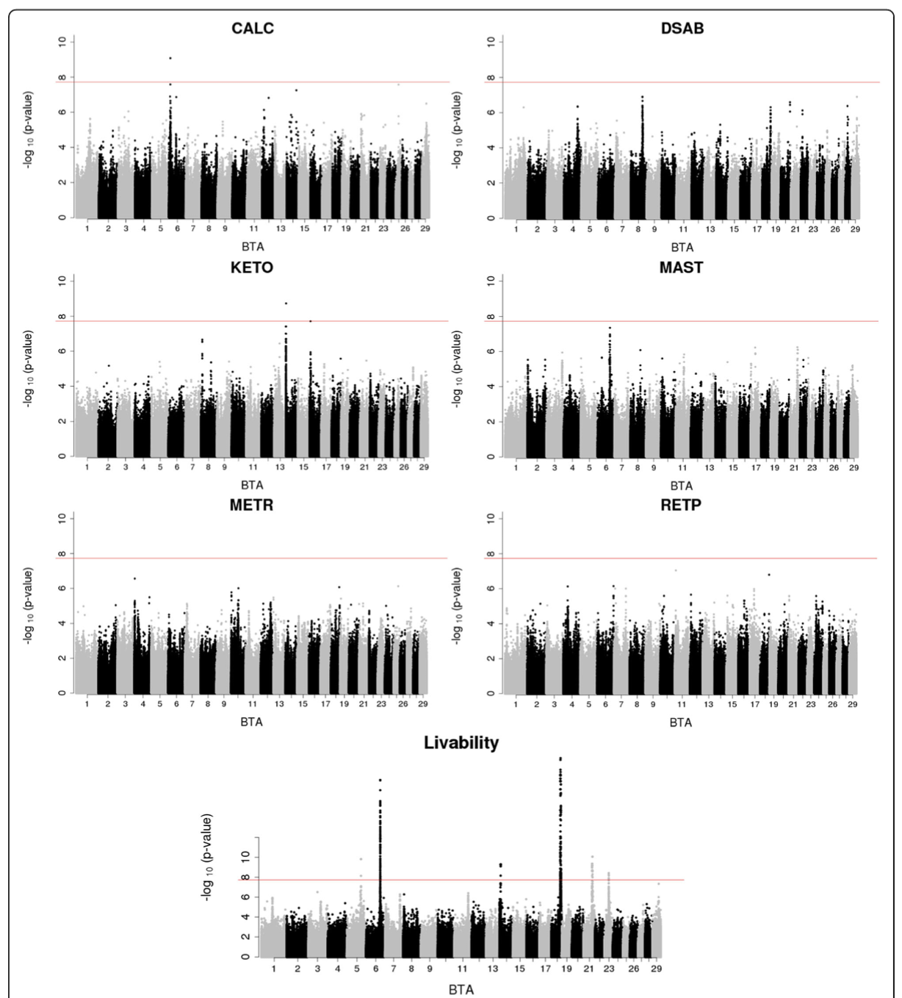
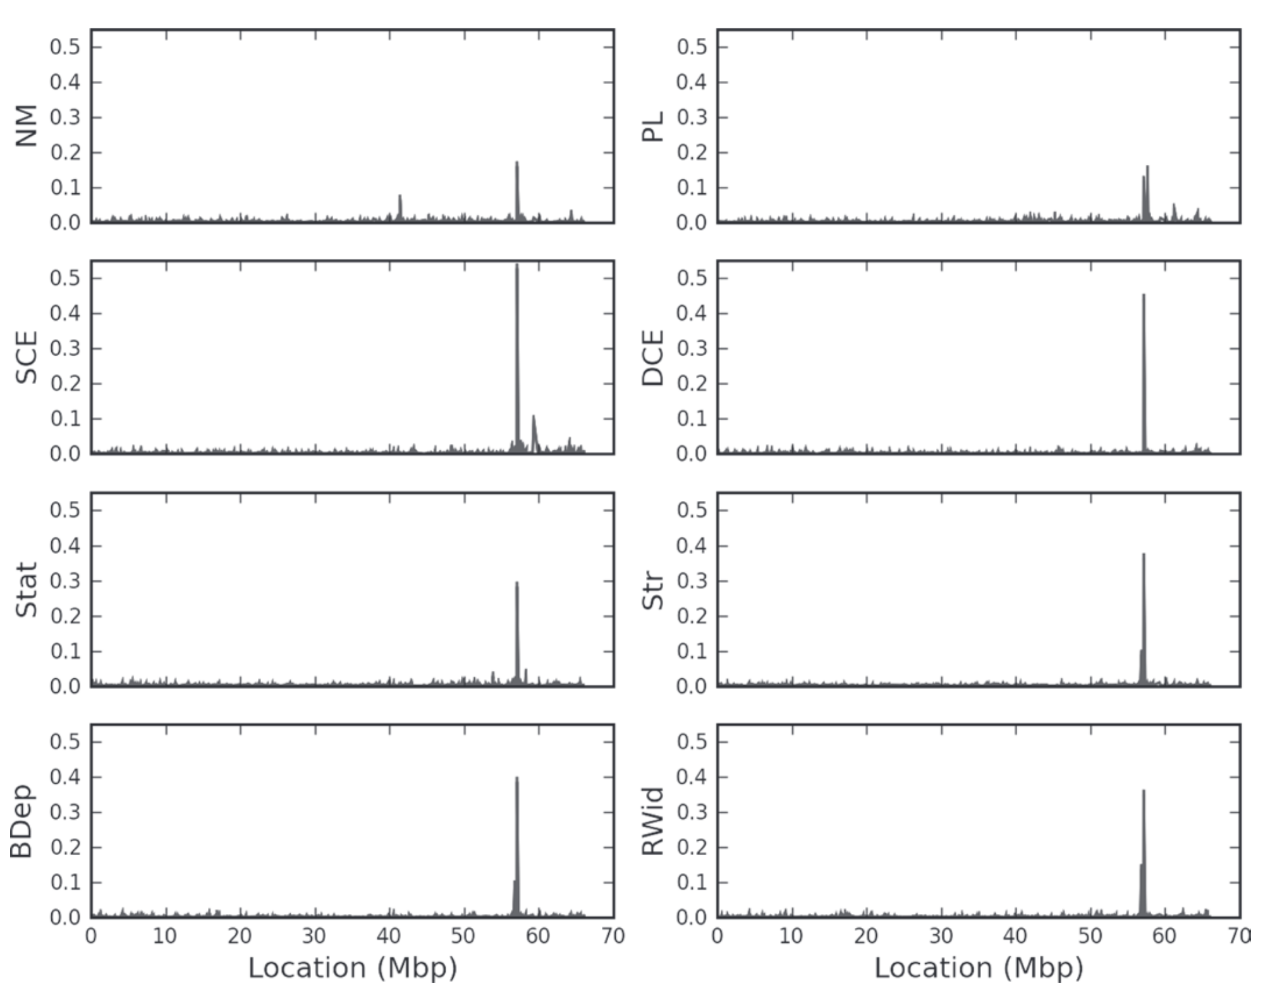
Where are the QTL?
Cole et al. (2009; https://doi.org/10.3168/jds.2008-1762)
Freebern et al. (2020; https://doi.org/10.1101/775098)

Slide 17
Genomic tools

Slide 18
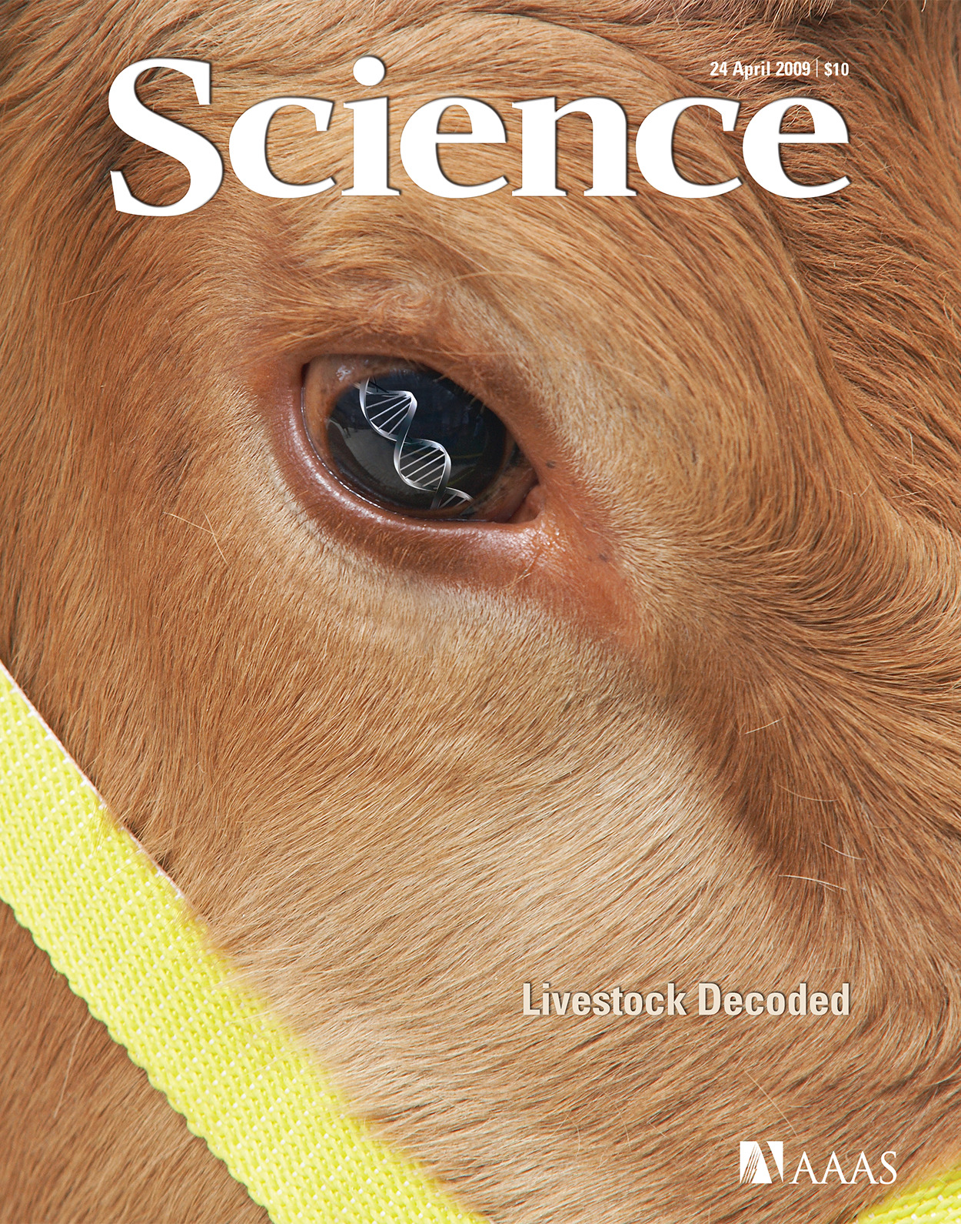
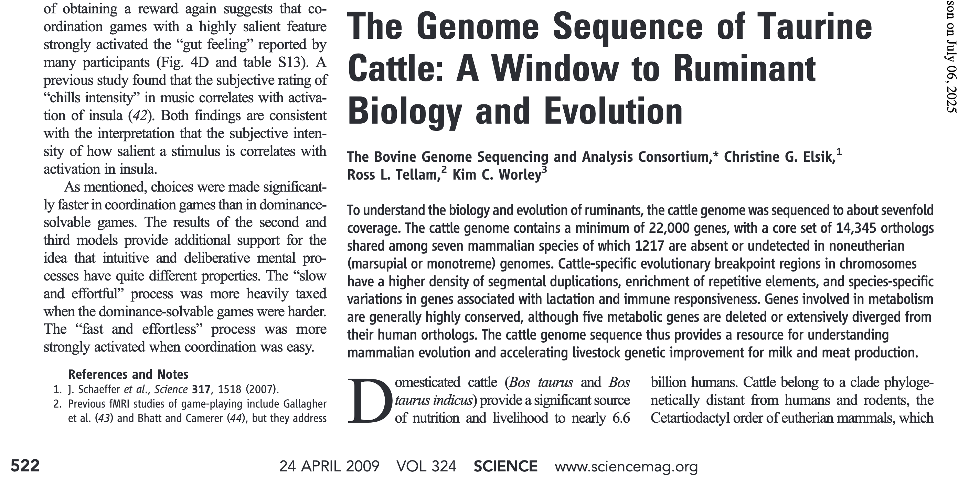
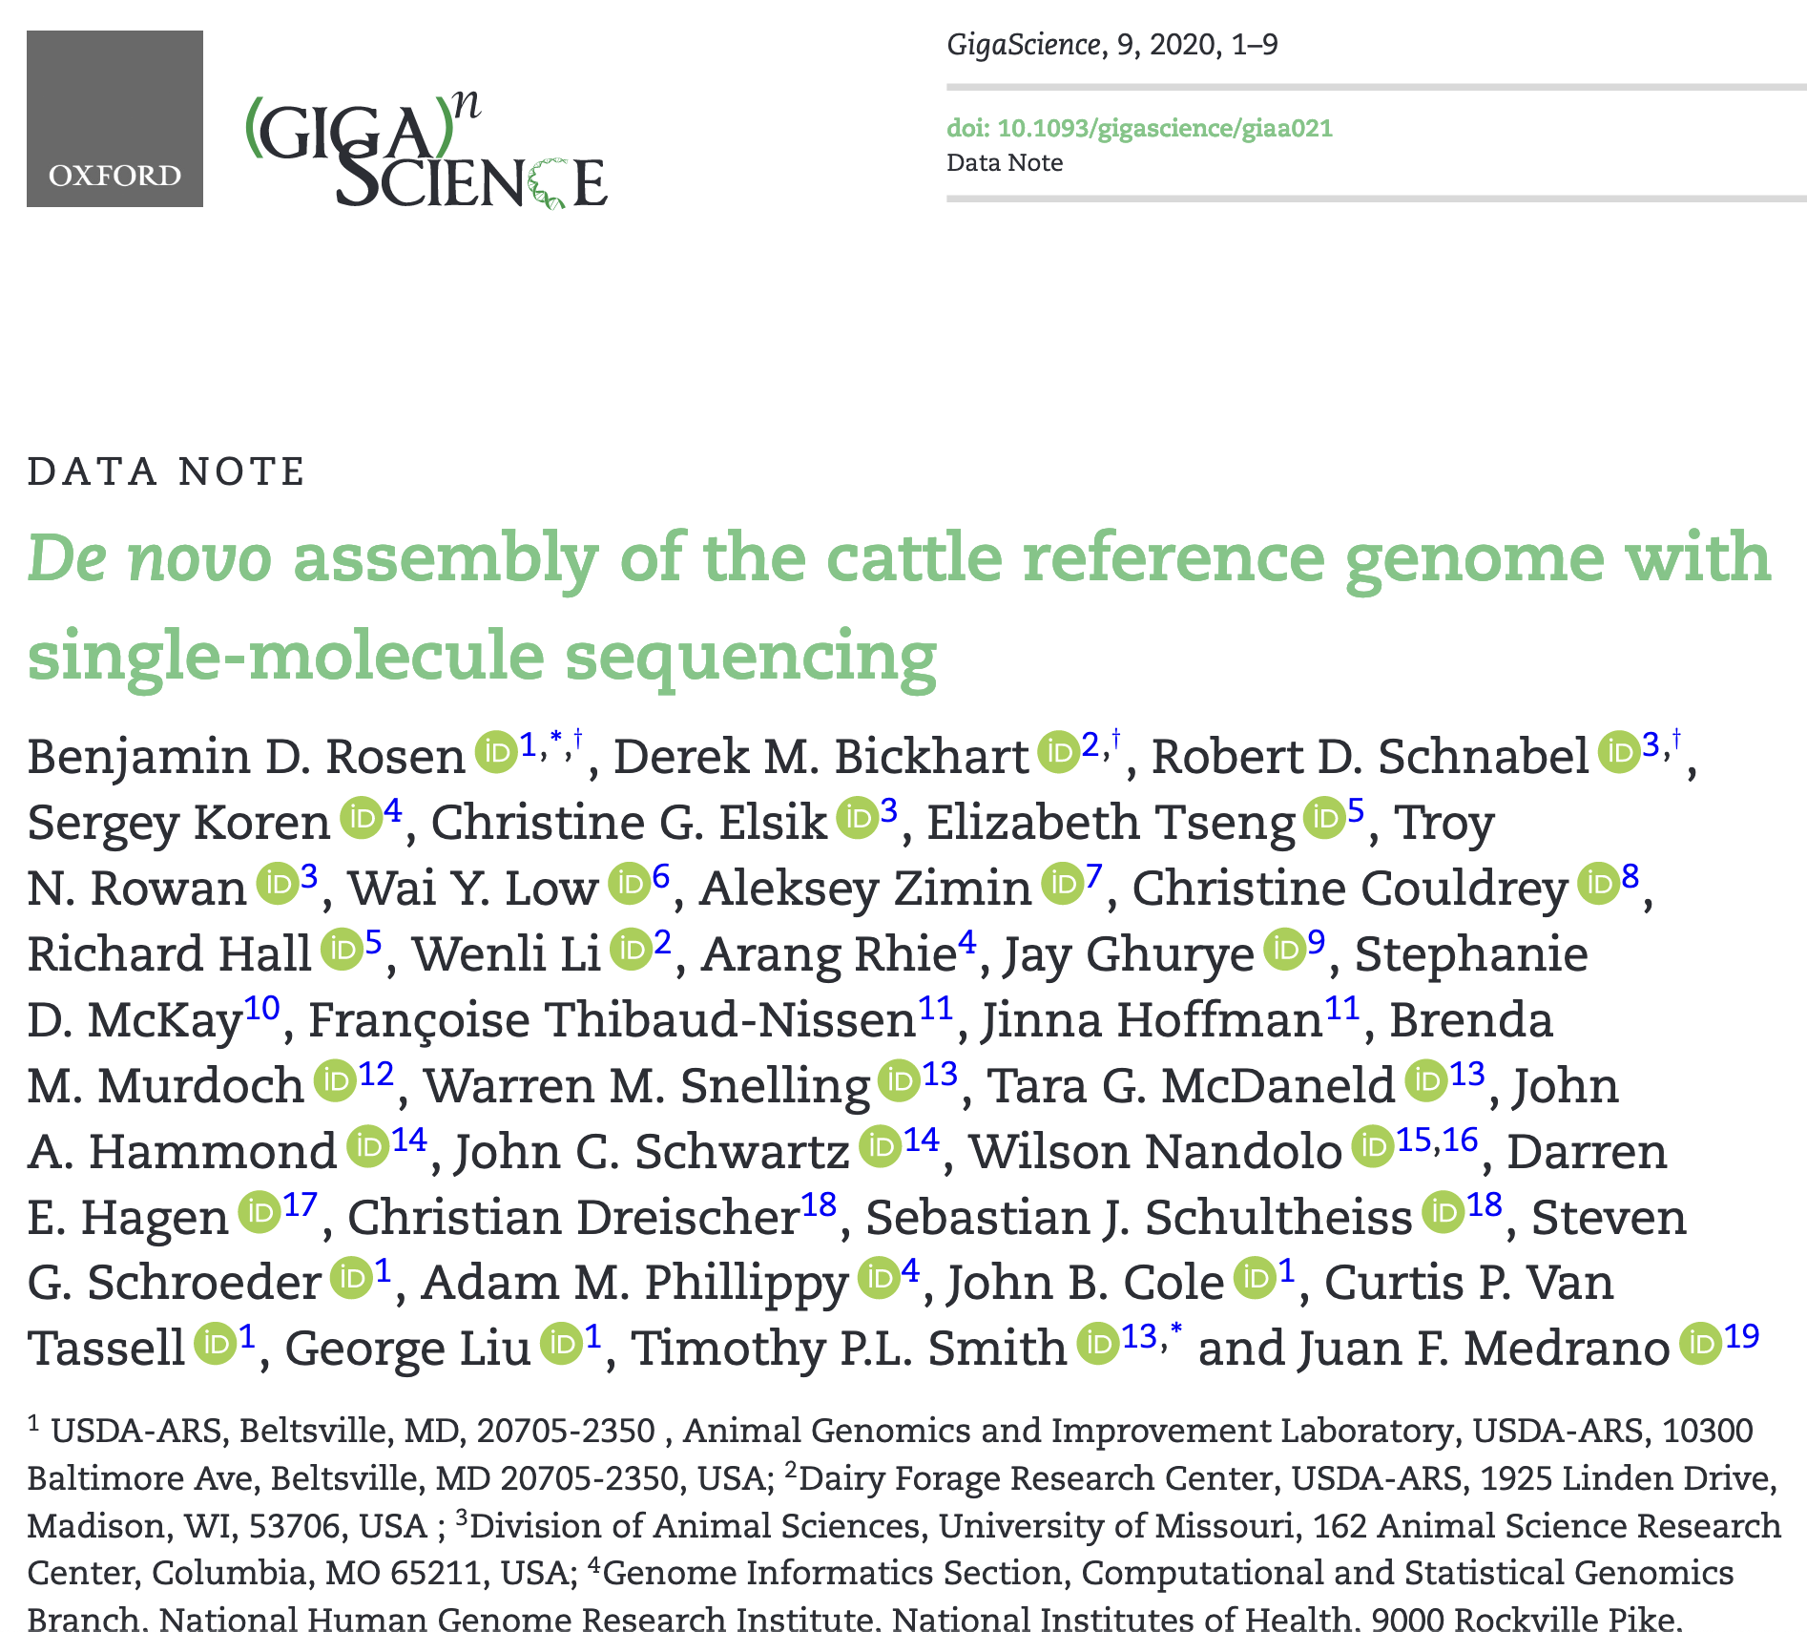
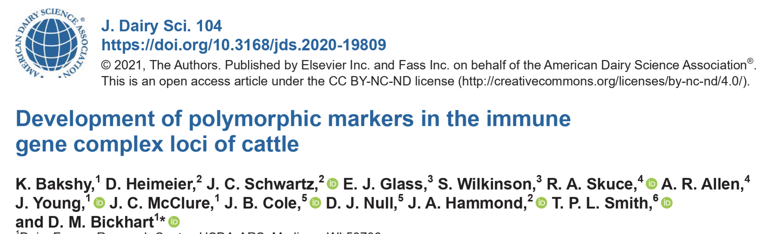
Reference genomes

Slide 19
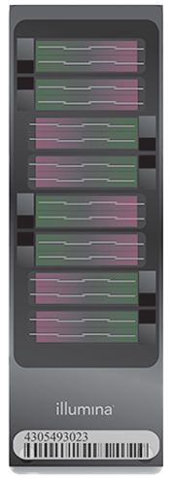
Genotyping arrays
57 chips currently supported
New chips added to:
  Accommodate SNP recently discovered to be important
  Lower costs of genotyping by including subsets of greatest
  interest
  Accommodate new technology
First sequence-based genotypes approved in May
  Low-pass sequence data with enriched targeted regions
Notes:
2

Slide 20
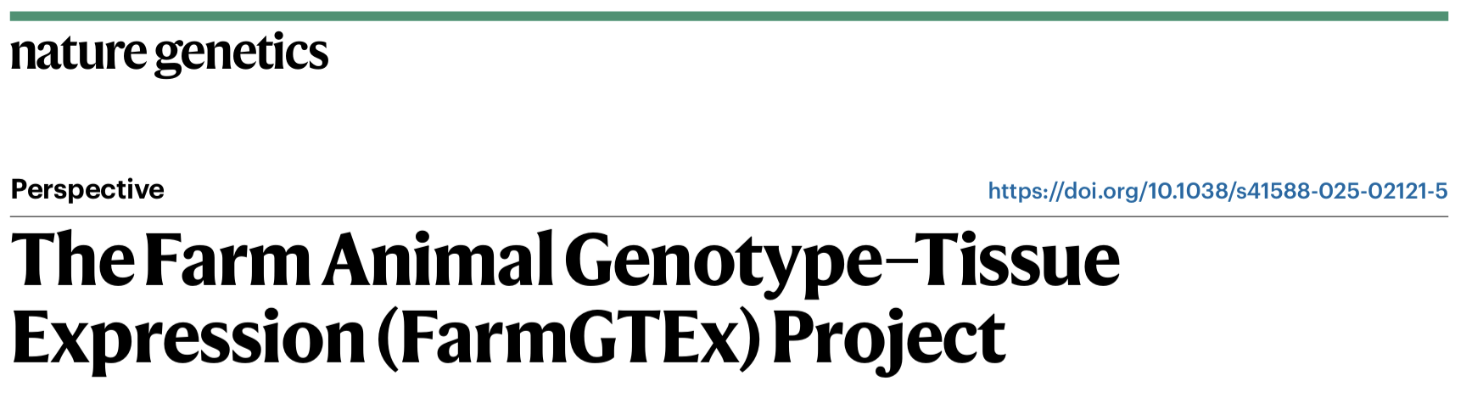
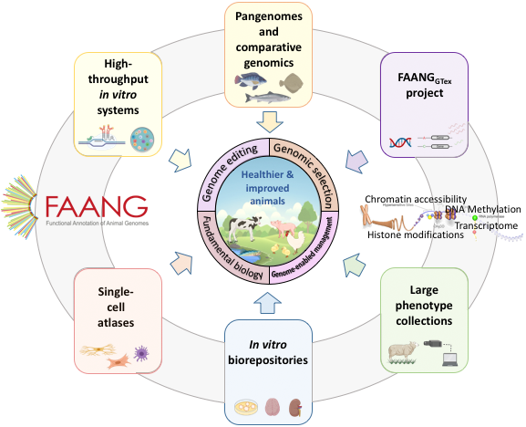
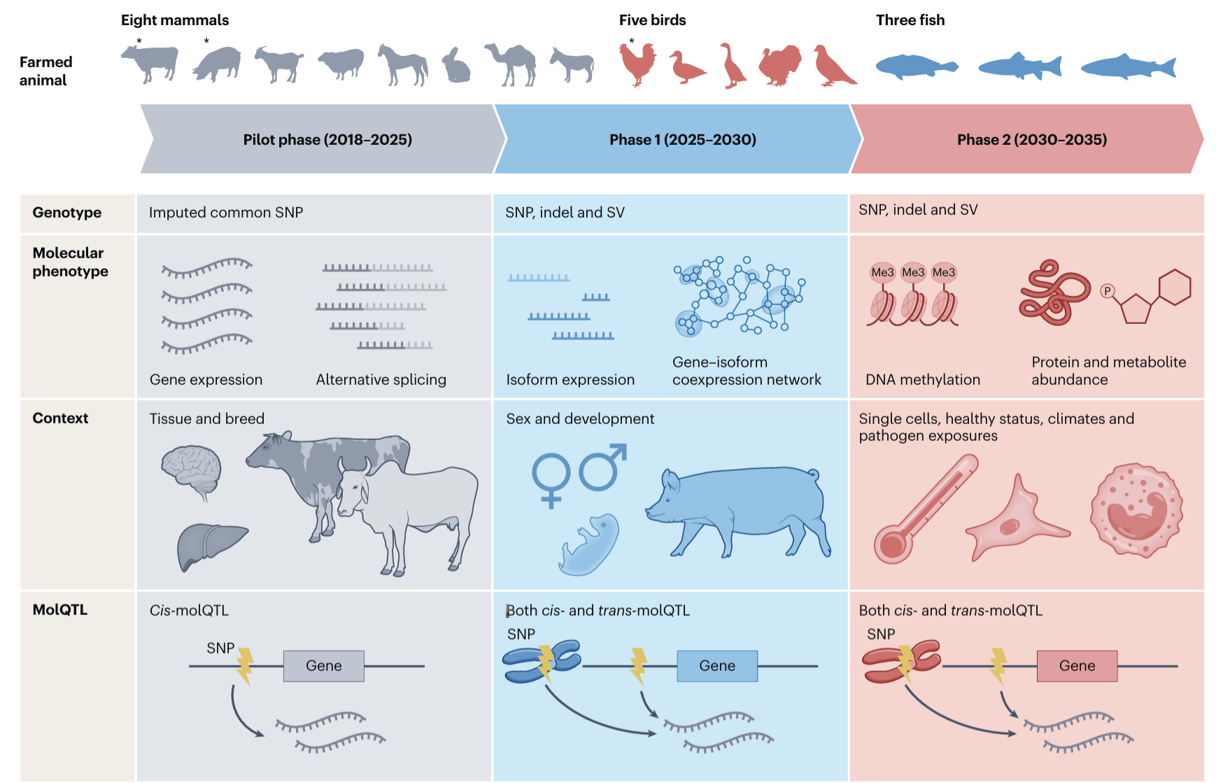
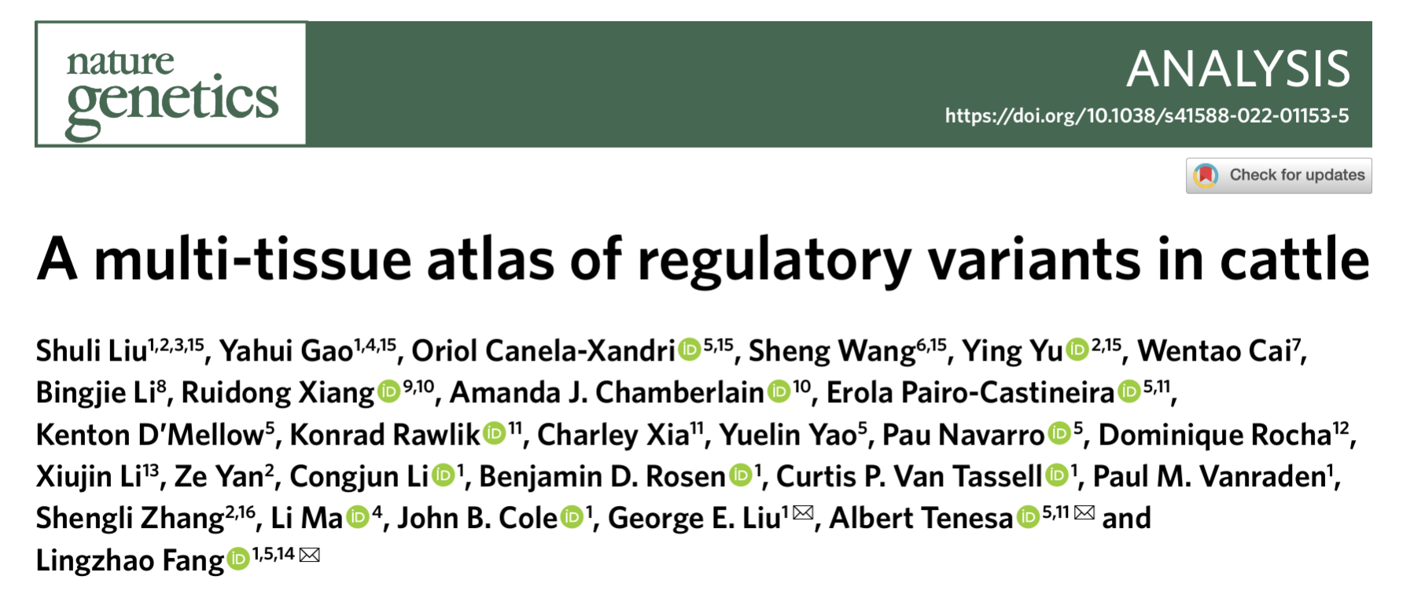
The growth of ‘omics

Slide 21
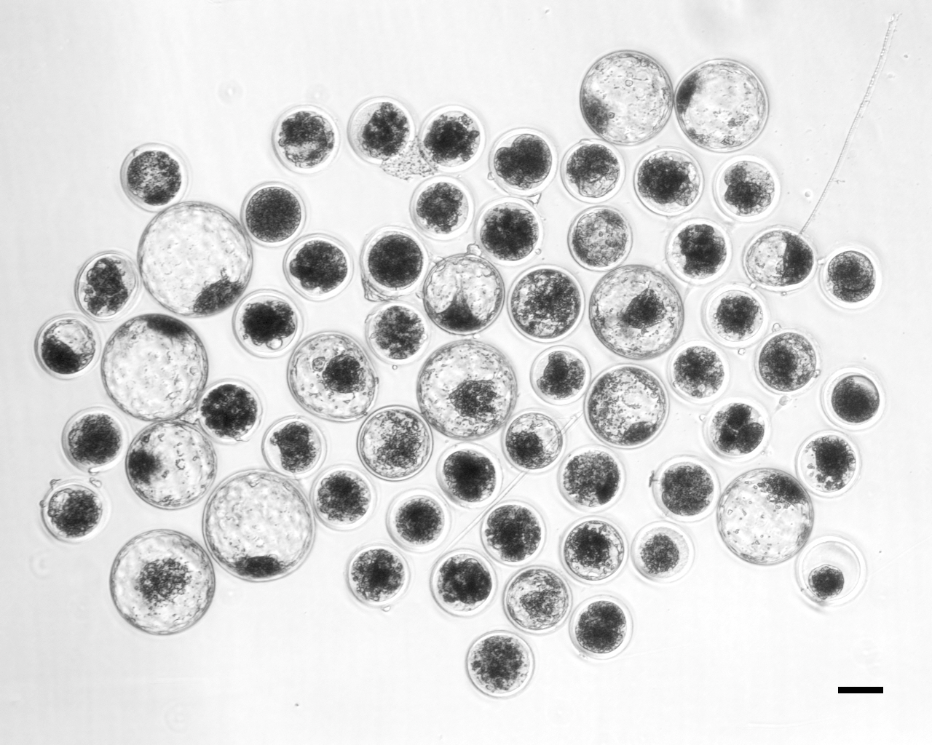
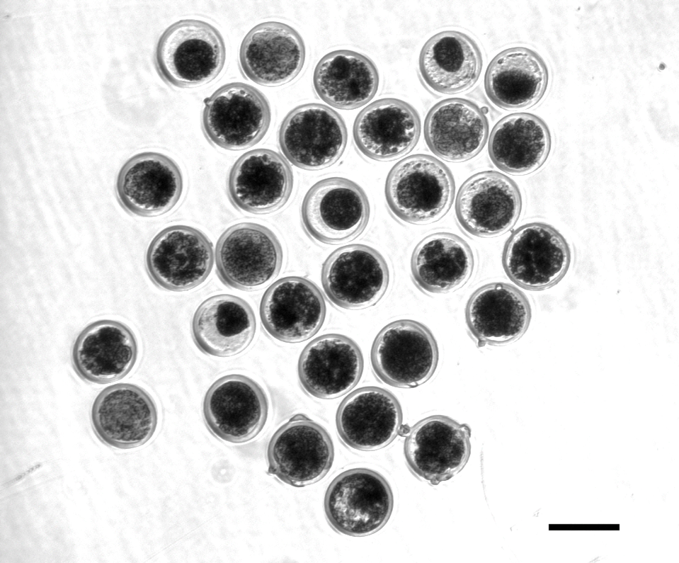
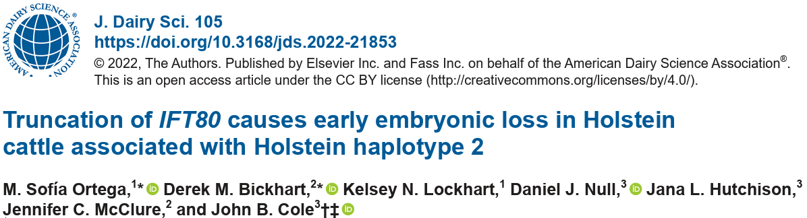
Functional validation of putative causals
A frameshift in IFT80 at 107,172,615 bp (p.Leu381fs) disrupts wnt and hedgehog signaling, and is responsible for the death of homozygous embryos
Control embryos injected with only Cas-9 (left)
Treatment embryos injected with Cas-9 and IFT80 exon 2 guide RNA (right)

Slide 22
Adoption by industry

Slide 23
Genetic merit of marketed Holstein bulls
Average gain:
$80.65/year
Average gain:
$35.48/year
Average gain:
$2.88/year

Slide 24
Generation interval – Holstein
Genomic evaluations became official for Holsteins in January 2009
After Guinan et al. (2023; https://doi.org/10.3168/jds.2022-22205)

Slide 25
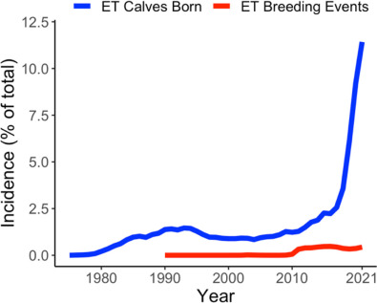
Embryo transfer has grown rapidly
Benefits from ET may be higher than AI due to higher conception rates and faster rates of genetic gain (Kaniyamattam et al., 2017)
Terminal ET programs may help maximize value in complex breeding systems
Miles et al. (2023; https://doi.org/10.3168/jds.2022-22298)

Slide 26
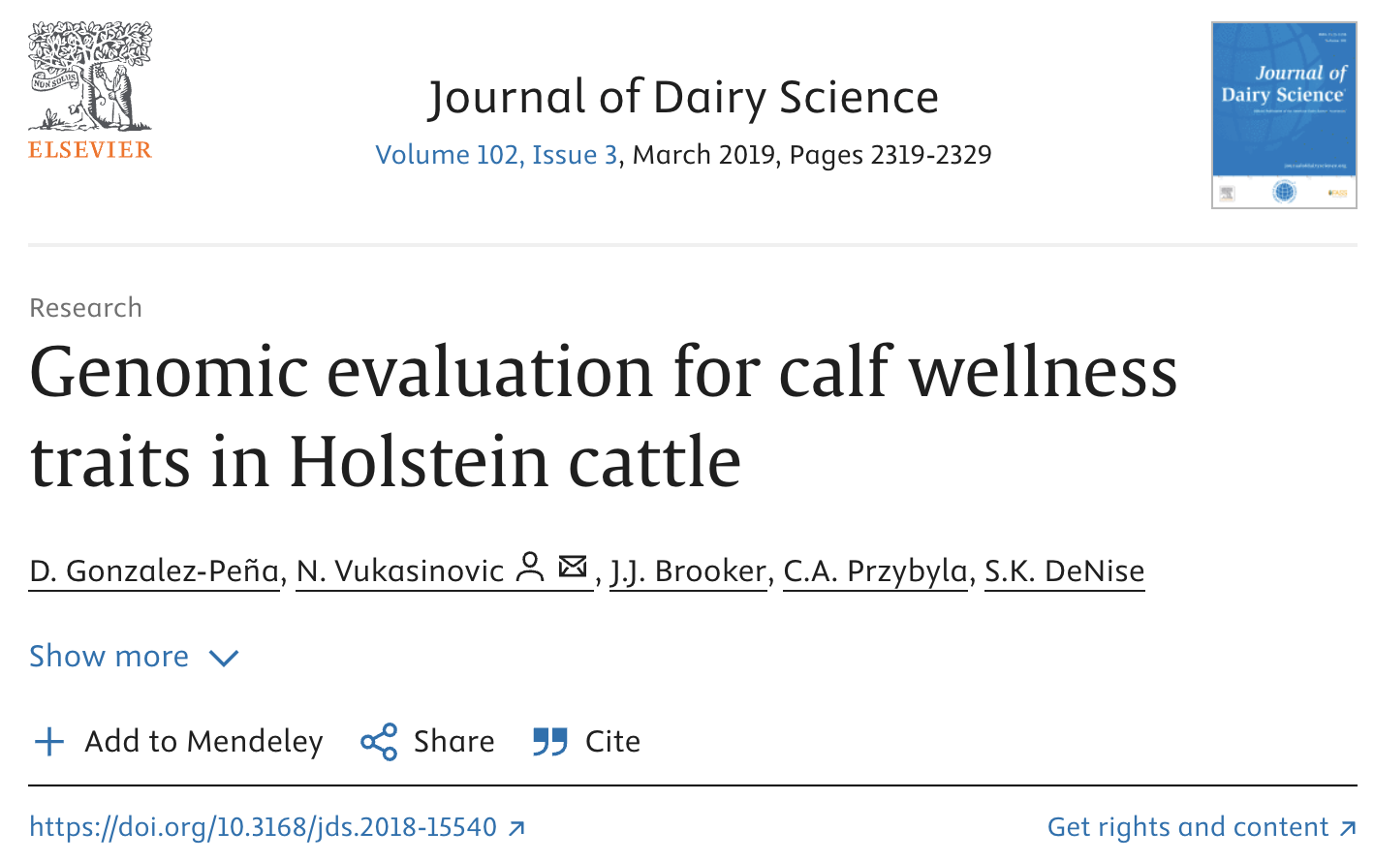
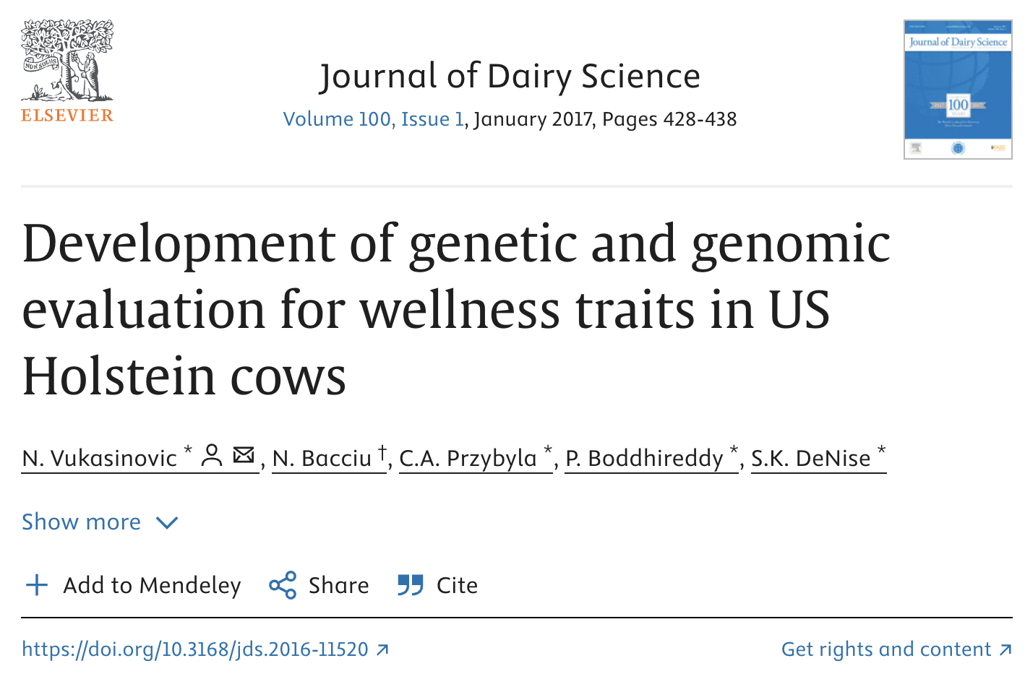
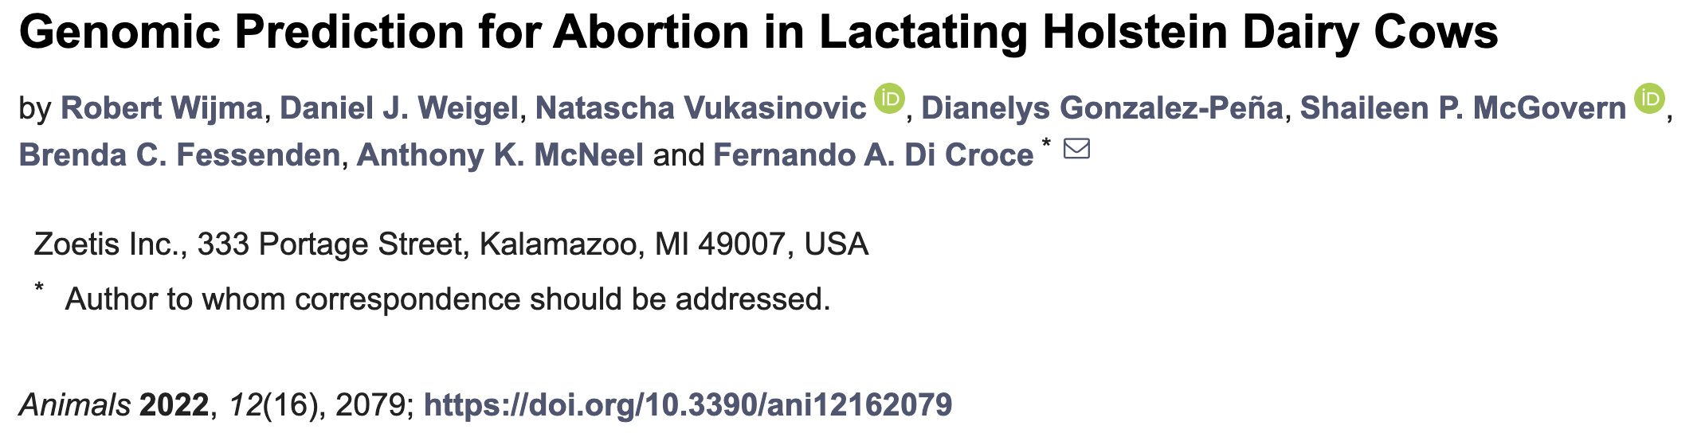
New industry players have emerged
Genetic evaluations for novel traits are being offered by companies that are not genetic evaluation centers
This was not anticipated early in the genomics era

Slide 27
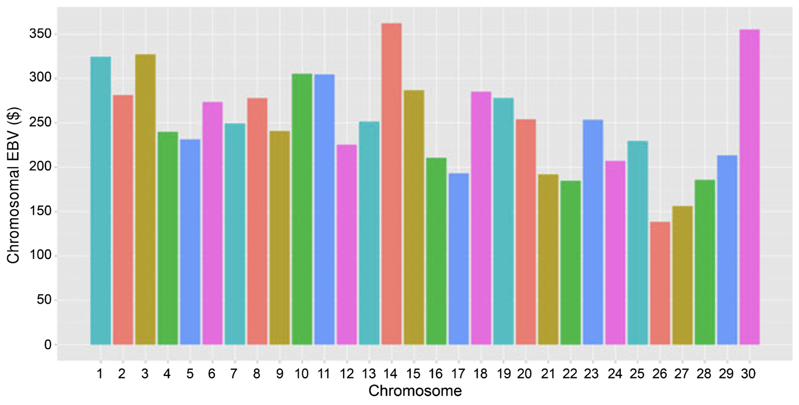
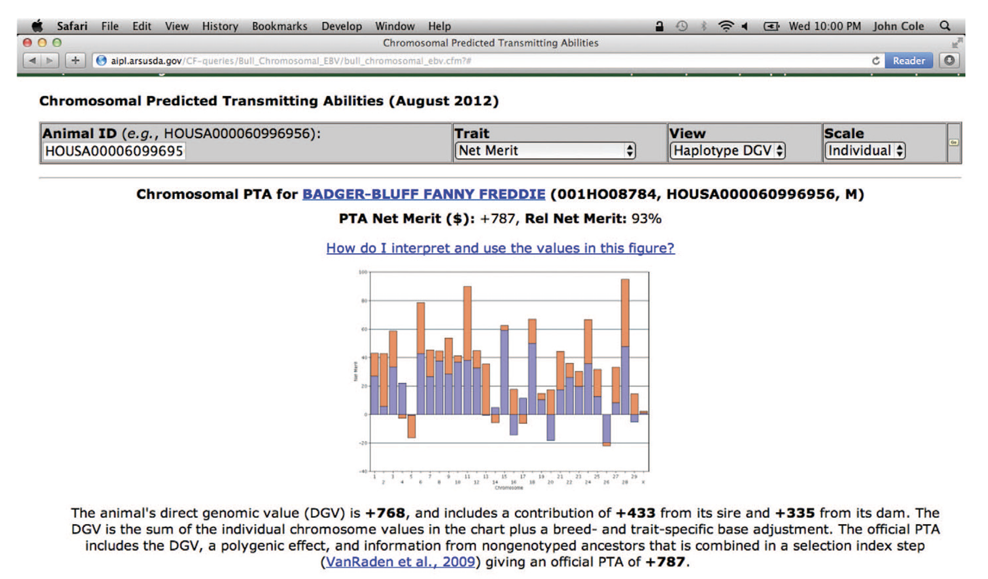
A picture’s worth 1,000 words
Cole and VanRaden (2010; https://doi.org/10.1111/j.1439-0388.2011.00922.x)
Cole and Null (2013; http://dx.doi.org/ 10.3168/jds.2012-6008)

Slide 28
Expensive traits are now within reach
Many traits of economic importance are very expensive to measure and have low heritabilities
Increased reliabilities from genomics make effective genetic selection possible in these cases

Slide 29
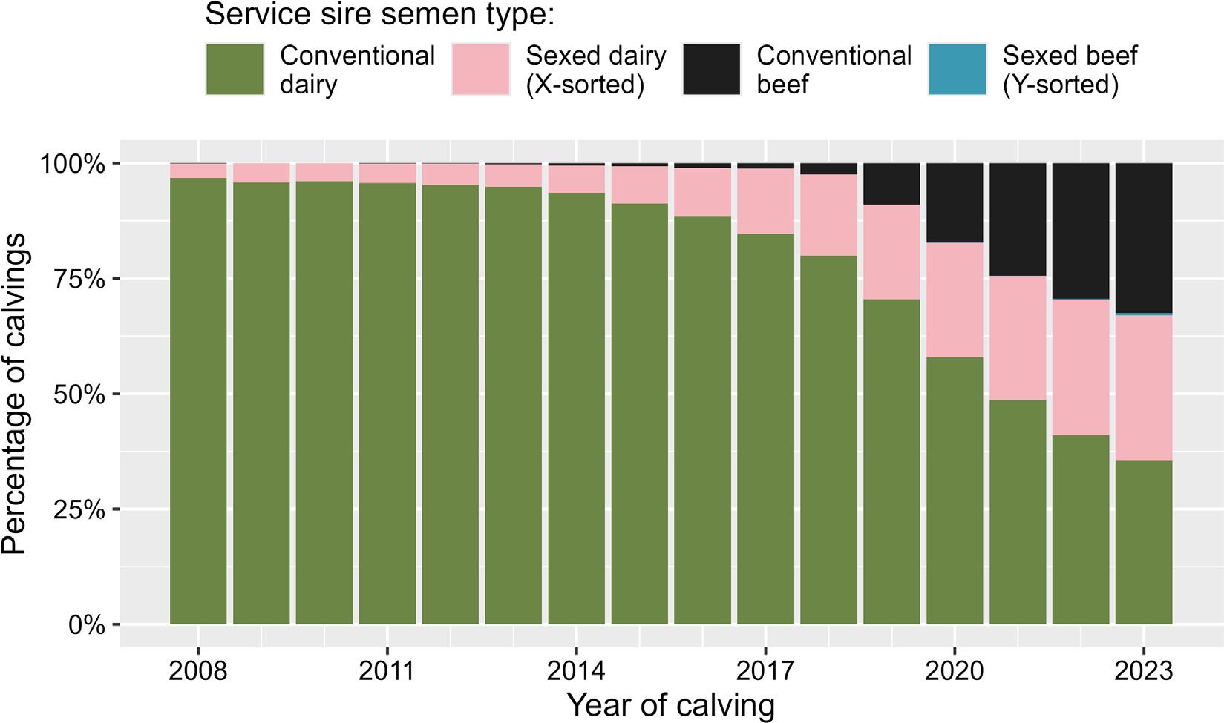
Breeding strategies
The availability of sexed semen at competitive prices and historically high beed prices have led dairy farmers to adopt sophisticated breeding strategies using many new technologies
Basiel et al. (2025; https://doi.org/10.3168/jds.2025-26600)

Slide 30
Future directions

Slide 31
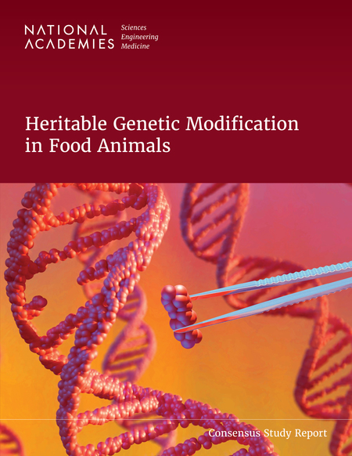
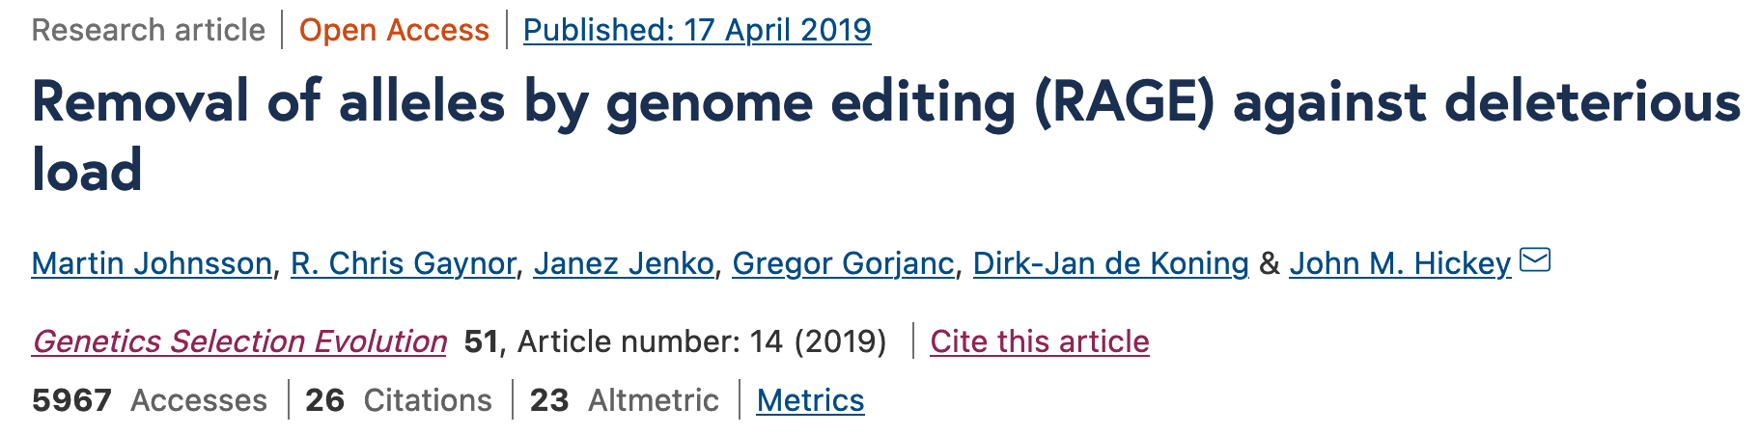
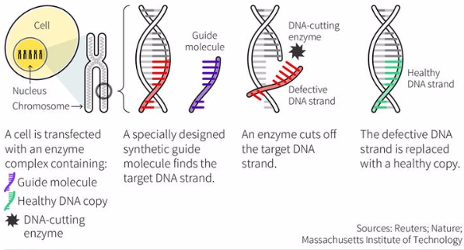
Gene editing
Can we use gene editing to “fix” defects when we find them?
Then we can get rapid genetic gain without negative consequences!
But do we know what we loci need to edit?

Slide 32
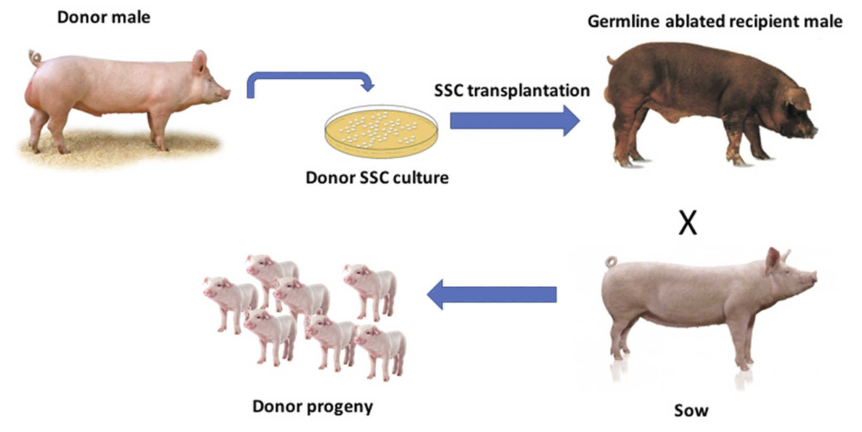
Surrogate sires
Implant stem cells of genetically elite animals into surrogates, which produce the donor’s gametes
Multiplies germplasm available for breeding
Substantial technical hurdles remain, but progress is being made

Slide 33
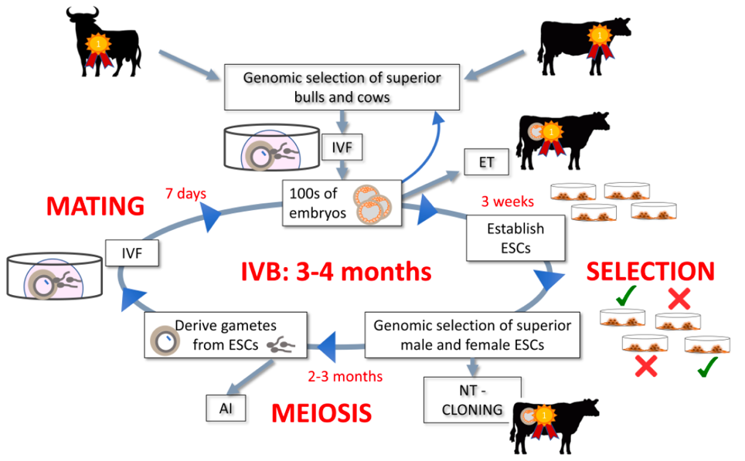
In vitro breeding
Embryonic stem cells can be turned into sperm and eggs and used to create a new generation of embryos (Goszczynski et al., 2018, PMID: 30551176)
Faster genetic gain because time needed to create next generation is shortened
Live animals eventually needed

Slide 34
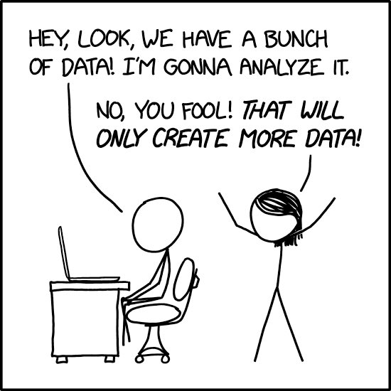
The promise of prediction
Many data now available to farmers
Can be used to predict cow performance
Also may support precision management schemes

Slide 35
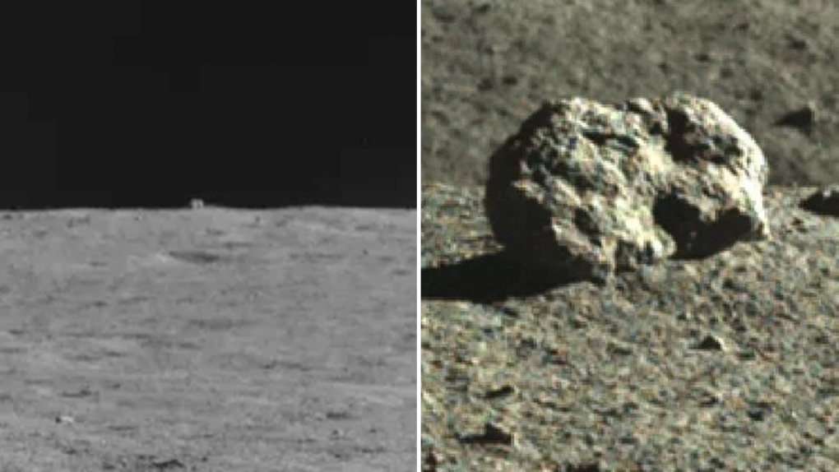
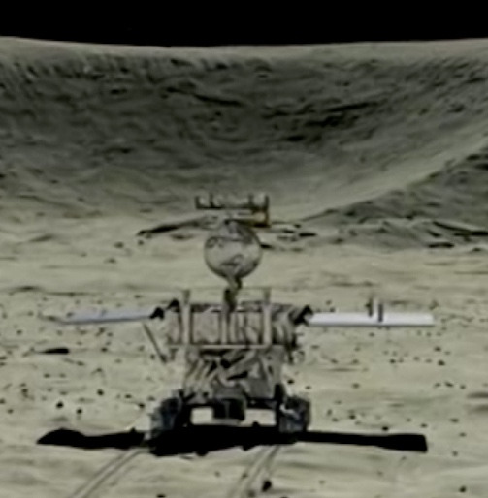

Some perils of prediction

Slide 36
So many “Thank you!”s are needed…
Mentors
Wayne Adkinson
Don Franke
Bob Godke
Les Hansen
Eldin Leighton
USDA
Randy Baldwin
Derek Bickhart
Erin Connor
Tabatha Cooper
Kim Fletcher-Carroll
Rob Goodling, Jr.
Jason Graham
Jana Hutchison
George Liu
Laura Melton-Thornton
Asha Miles
Mahesh Neupane
Duane Norman
Dan Null
Ben Rosen
Steven Schroeder
Mel Tooker
Curt Van Tassell
Paul VanRaden
George Wiggans
University Collaborators
Christine Baes
Bennet Cassell
Brian Crooker
Yang Da
Serdal Dikmen
Alison Van Eenennaam
Lingzhao Fang
Peter Hansen
Jicai Jiang
Daniela Lourenço
Li Ma
Nicola Macciotta
Christian Maltecca
Filippo Miglior
Ignacy Misztal
Jeff O’Connell
M. Sofía Ortega
Francisco Peñagaricano
Flavio Schenkel
Bob Schnabel
Thomas Spencer
Hermann Swalve
Jerry Taylor
Francesco Tiezzi
Albert de Vries
Kent Weigel
Industry Colleagues
Peter Amer
John Clay
Sophie Eaglen
Robert Fourdraine
Fiona Guinan
Kaz Ingawa
Tom Lawlor
Jay Mattison
Jenn McClure
Matt McClure
Felipe Ruiz-López
Jon Scheffers
Tad Sonstegard
Cari Wolfe
ICAR Colleagues
Andrew Bradley
Christa Egger-Danner
Nicolas Gengler
Bjørg Heringstad
Jennie Pryce
Kathrin Stock
Collaborators in Brazil
Marcos V.G.B. da Silva
Fernando Cardoso
Daniel Dos Santor
Bento Ferraz
José Fernando Garcia
Patrícia Iana Schmidt
Yuri Utsunomiya
PEAK Colleagues
Doug Bjelland
Tatiane Chud
Ashley Mikush
Gaya Rajamanickam
Vianney Salmon
Michael Schmitt
Bob Welper
CDCB Colleagues
Lillian Bacheller
Clarissa Boschiero
João Dürr
Kristen Parker Gaddis
Andres Legarra
Jay Megonigal, Jr.
Ezequiel Nicolazzi
Frank Ross
Xiao-Lin (Nick) Wu
Students and Postdocs
Ahmed Al-Khudhair
Sarah Cochran
Ellen Freebern
Adriana García-Ruiz
Heatlher Bradford
Bingjie Li
Shuli Liu
Emmanuel Lozada-Soto
Maci Mueller
Juan Nani
Chen Yao
In Memoriam
D.H. “Denny” Crews, Jr.
Jan Wright

Slide 37
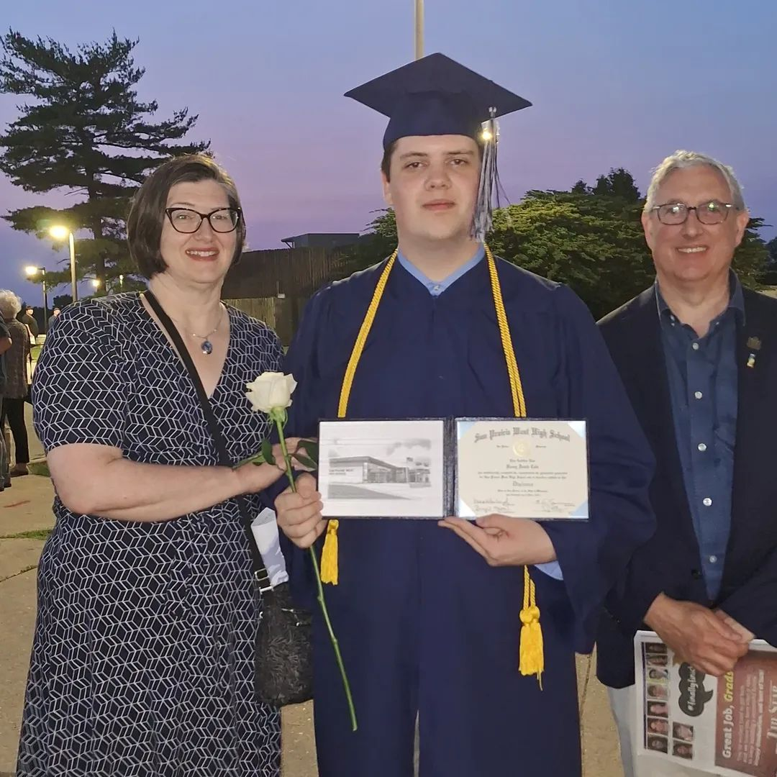
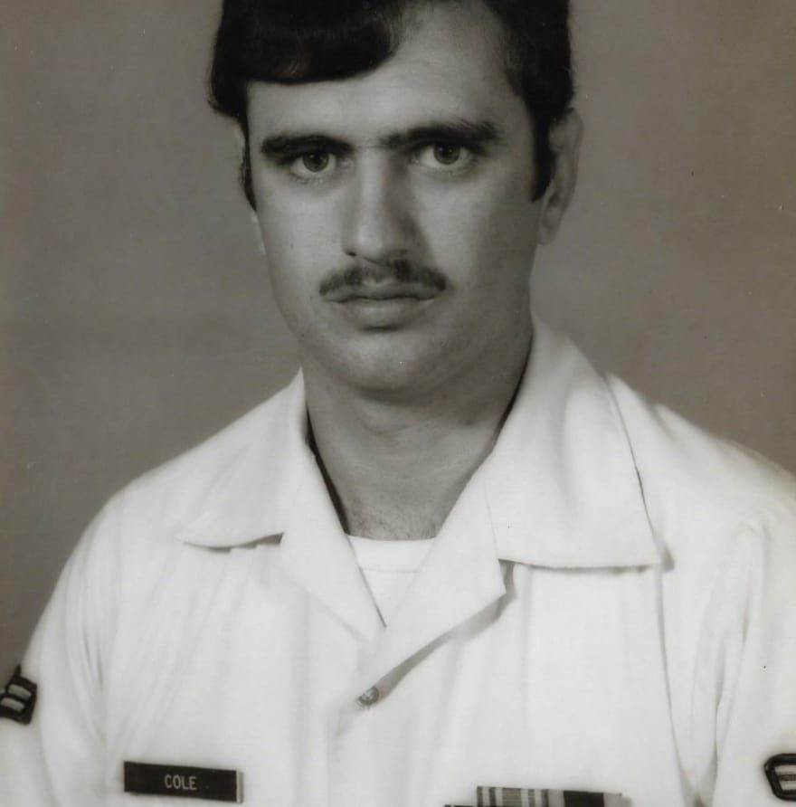
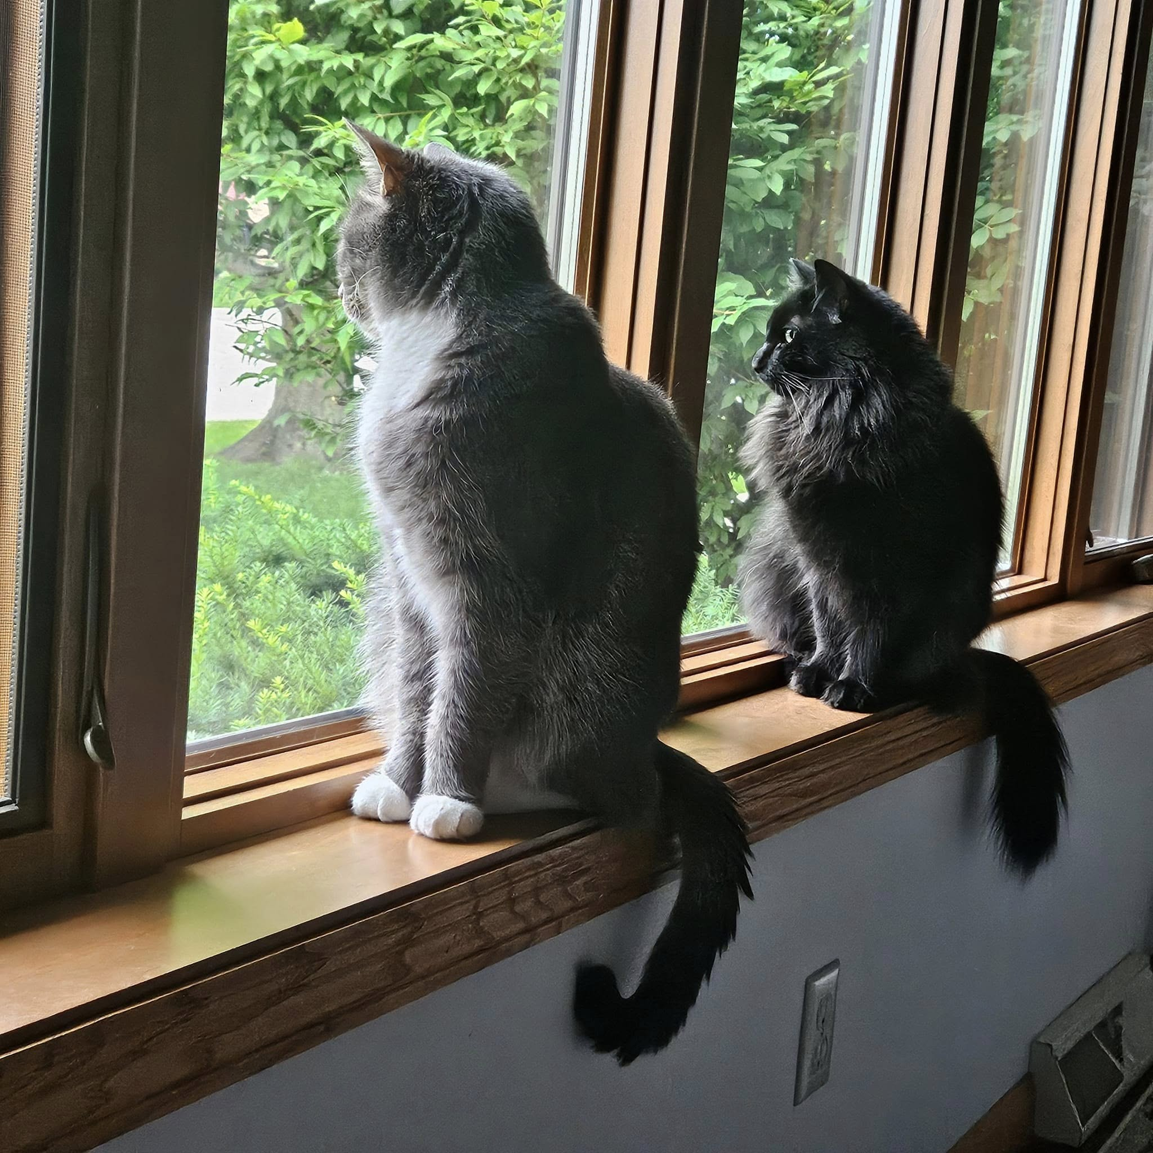
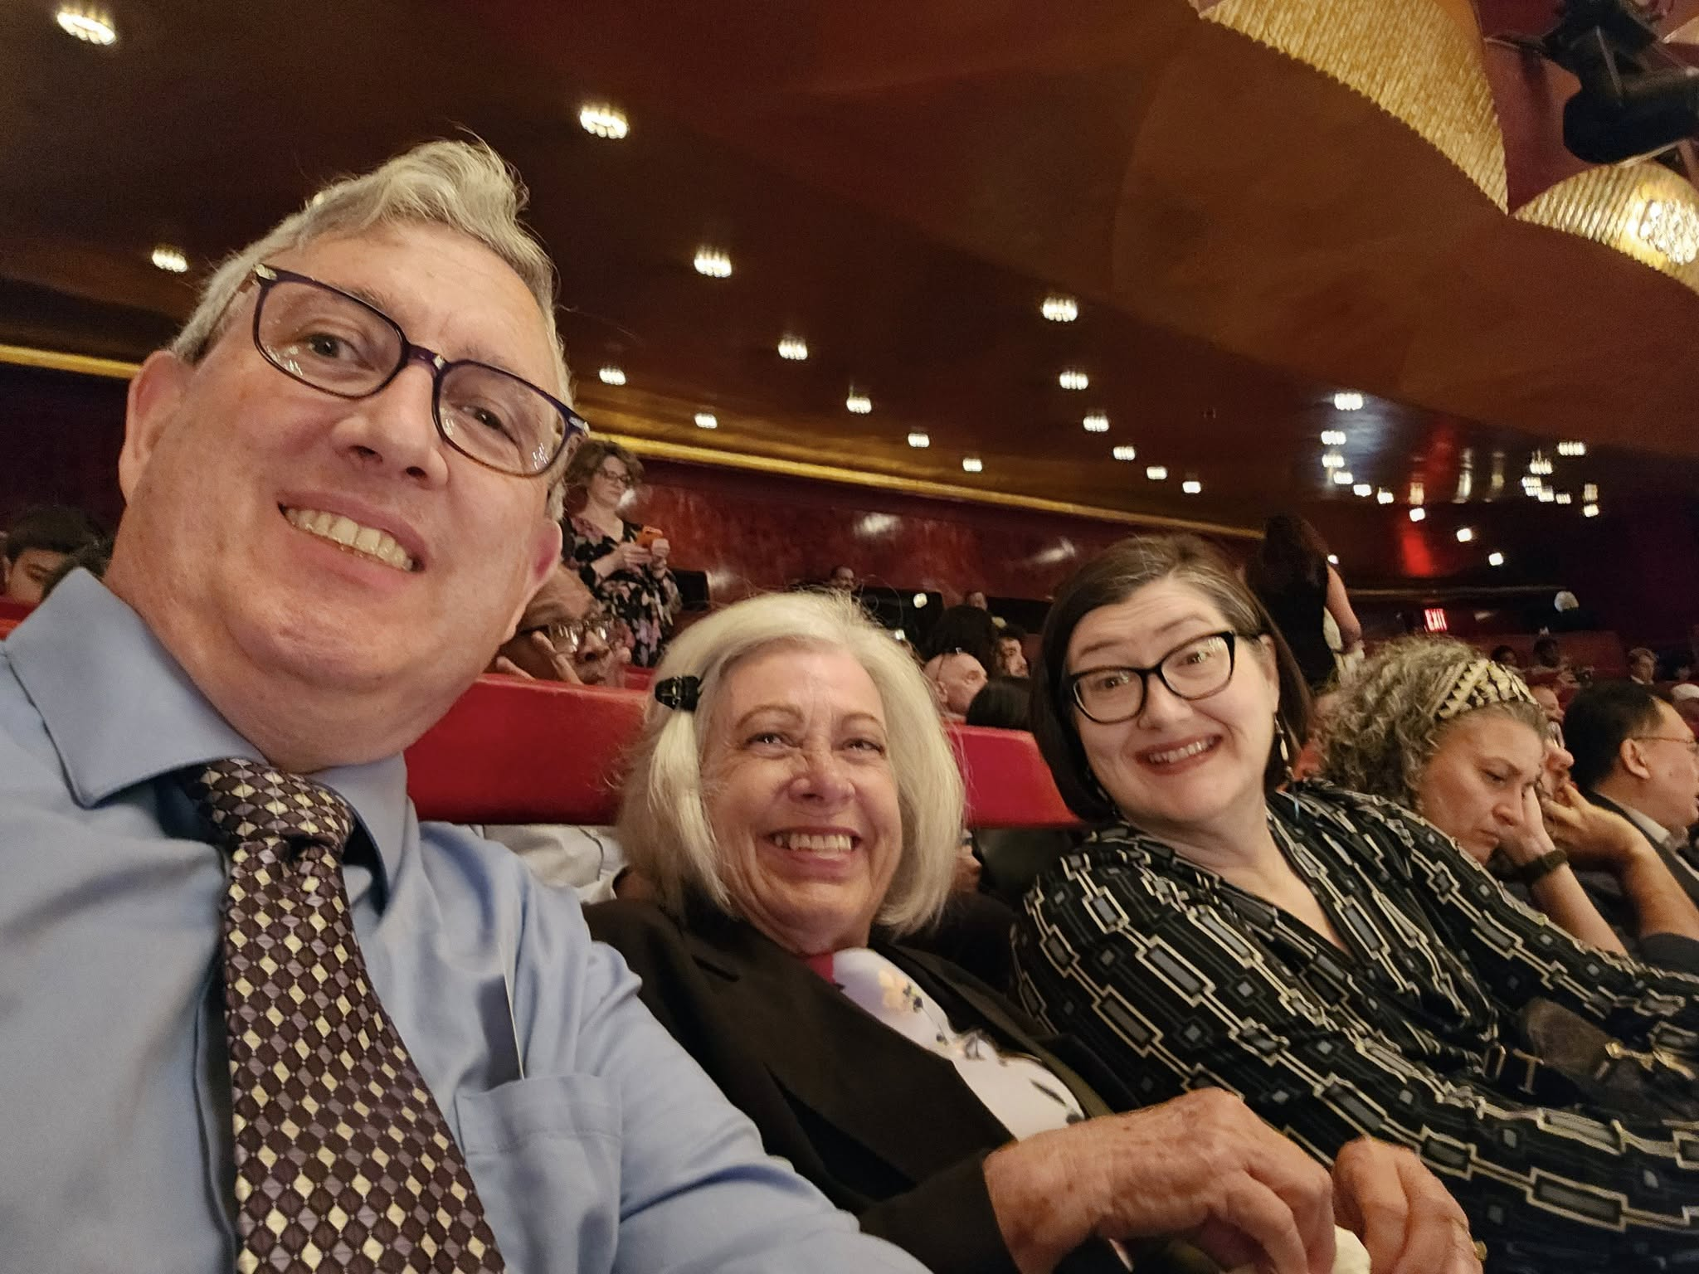
…but most of all to my family!

Slide 38
Acknowledgments
USDA-ARS project 8042-31000-113-00-D, “Improving Dairy Animals by Increasing Accuracy of Genomic Prediction, Evaluating New Traits, & Redefining Selection Goals”
PEAK Genetics, Madison, WI
Council on Dairy Cattle Breeding, Bowie, MD
Department of Animal Sciences, Donald Henry Barron Reproductive and Perinatal Biology Research Program, and the Genetics Institute, University of Florida, Gainesville
Department of Animal Science, North Carolina State University, Raleigh
Department of Animal Biosciences, University of Guelph, Ontario, Canada

Slide 39
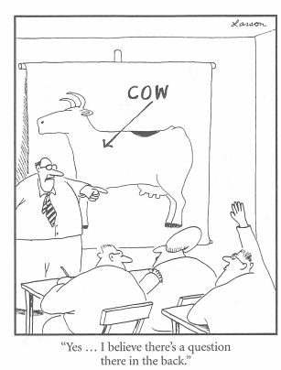
Questions?
Thank you for your
attention!
john.cole@uscdcb.com

